Slide 1

Progressive Education Society’s
Modern College of Arts, Science and Commerce, (Autonomous)
Shivajinagar, Pune – 411005.
OJT Project Presentation
“Multivariate Experiments Driven Product Strategy Optimization for Banking Products”
Presented by
Kiran Vishnu Sanap
Class: M.Sc. I (Statistics)
Roll No: 2433303

Slide 2

India’s banking sector stands as a pillar of the nation’s economic progress, playing a vital role in mobilizing capital, expanding credit access, and driving financial inclusion.

Slide 3
Why FD is important?
Certainty of returns: as they offer guaranteed interest earnings regardless of market fluctuations.
Tax benefits: Tax deduction under section 80C of up to 1.5 lakh when we make an investment on a tax saver FD scheme with a minimum lock in period of five years.
Capital stability: FDs provide banks with predictable inflows, allowing better planning for loans and advances.

Slide 4
Problem statement: Decline in FD satisfaction
Economic Conditions and Monetary policy: The RBI sets the repo rate. When the RBI lowers the repo rate, it becomes cheaper for banks to borrow money, additionally they tend to reduce their FD interest rates accordingly.
Alternative investments options: Mutual funds, stock market, government securities.
Longer Tenures:
Banks offer higher interest rates for long term FDs.

Slide 5
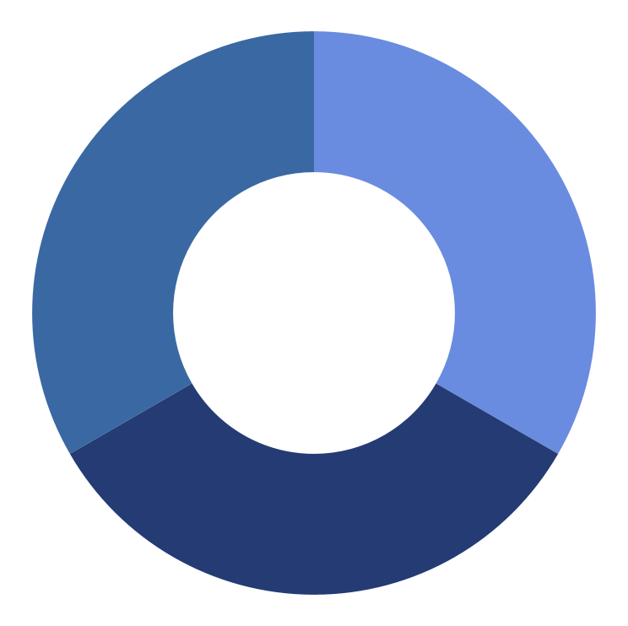
Goal: Redesign FD Using Data & Business Experiments
The main objective is to use data analytics and customer feedback to redesign and optimize FD offerings to align better with customer preferences and business goals.
This includes:
Testing new interest rate slabs or promotional offers.
Personalizing FD terms like tenure, withdrawal flexibility, or auto-renewal features.
Enhancing communication and digital access to FD services.

Slide 6
Framework Used: Lean Six Sigma (DMADV)
1
2
3
4
5
Define
Measure
Analyze
Design
Validate
Identifying the problem and setting clear project goals.
Gathering relevant data on key performance indicators.
Exploring the underlying factors influencing customer preferences and satisfaction.
Developing data-informed strategies to improve the FD product and its positioning.
Testing and confirming the effectiveness of these strategies through business experiments.

Slide 7
Conceptual Framework
Business Experiment & Analytics:
Business Experiments are about testing new ideas or changes—like a new product, service, or process on a small scale before applying them fully. This helps businesses see what works and what doesn’t, so they can avoid mistakes and reduce risk. The goal is to:
Try out new ideas or improve existing ones,
Learn how changes affect results,
Make better decisions with less risk.
Business Analytics means studying data to understand how the business is doing, spot patterns or problems, and plan better for the future. The goal of analytics is to:
Understand past performance,
Find trends and insights,
Make smarter decisions for both daily operations and long-term planning,
Predict future outcomes.

Slide 8
Lean Six Sigma DMADV:
Define →Measure → Analyse → Design → Validate
Define Phase – Identify the Problem
The bank observed that customer satisfaction for its FD products has dropped in the last two quarters.
Other banking services still have high ratings.
The drop may be due to increased competition and customers preferring mutual funds or other investment options.
The goal is to redesign the FD product to make it more appealing and improve customer satisfaction.

Slide 9
Measure Phase – Understand Key Features :
Measure Phase involves measure input features or root causes that impact the problem.
Group of experienced bank officials- Branch Manager, Asst. managers and experienced bank employees from FD division came up with the features they are providing to customers currently and the new features they can provides to the customers are as given in table:
 | NO. FO FEATURES / FACTORS OF FD SCHEMES AT CICIC |  | NEW OFFER
Sr.No |  | CURRENT OFFER
1 | Deposit Term & Interest rate | Min. 21 days with interest rate of 1.75% | Min. 50 days with interest rate of 4.75%
2 | Minimum Deposit Amount Allowed | Rs.10, 000 /- | Rs.15, 000 /-
3 | Interest Payment Frequency | Monthly interest payments | Quarterly interest payments
4 | Early Withdrawal Penalty | 0.5% of the principal amount | 1% of the principal amount
5 | Account Access | Online access and management | Phone-based customer service and support
6 | Renewal Options | Automatic renewal at maturity | Option to renew and add
 |  |  | additional funds at maturity
7 | Add Up Services with FDs | Overdraft facilities | Option to take a loan against the
 |  |  | fixed deposit
8 | Loyalty Offers and Benefits | Loyalty rewards or bonus interest | Discounts on bank's other
 |  | rates | services

Slide 10
Feature selection
A brainstorming session was conducted to shortlist optimal FD feature offerings.
5 best features were selected based on Attractiveness to customers, Cost-effectiveness, Ease of implementation
Each feature had 2 levels (offers).
Total combinations = 2⁵ = 32
Each combination was replicated 10 times → 320 combinations
Combinations were converted into 80 questionnaires (4 questions each) using Pursullence’s Analytics Software.
Data was collected from 80 customers using rating-based conjoint analysis.
# | DENOTATION | FEATURES | LEVEL1 | LEVEL 2
1 | A | Deposit Term & Interest rate | Min. 21 days with interest rate of 1.75% | Min. 50 days with interest rate of 4.75%
2 | B | Minimum Deposit Amount Allowed | Rs.10, 000 /- | Rs.15, 000 /-
3 | C | Account Access | Online access and management | Phone-based customer service and support
4 | D | Renewal Options | Automatic renewal at maturity | Option to renew and add additional funds at maturity
5 | E | Add Up Services with FDs | Overdraft facilities with Option to take a loan up to 50% against the fixed deposit | Option to take a loan up to 110% against the fixed deposit

Slide 11
Analyse Phase – Data Analysis and interpretation
Slope coefficient – shows which offers are most preferred
P-value – indicates how significant each feature is

Slide 12
Feature | p-Value | Risk (%) | Assurance (%) | Interpretation
Deposit Term & Interest Rate | 0.139 | 13.90% | 86.10% | Moderately important, not highly significant.
Minimum Deposit Amount Allowed | 0.129 | 12.90% | 87.10% | Moderately important, somewhat significant.
Account Access | 0.039 | 3.90% | 96.10% | Highly significant, strongly preferred.
Renewal Options | 0 | 0.00% | 100% | Most significant, customers definitely prefer this feature.
Add Up Services with FDs | 0.272 | 27.20% | 72.80% | Less significant, not strongly preferred.
Feature | Slope Coefficient (β) | Customer Preference | Action for Bank
Deposit Term & Interest Rate | 0.824 | Customers prefer new offer | Change to: Min. 50 days with interest rate of 4.75%
Minimum Deposit Amount Allowed | 0.845 | Customers prefer new offer | Change to: Min. deposit of ₹15,000
Account Access | 1.152 | Customers prefer new offer | Change to: Phone-based customer service & support
Renewal Options | 2.964 | Customers prefer new offer | Change to: Option to renew and add funds at maturity
Add Up Services with FDs | –0.611 | Customers prefer current offer | Retain: Existing overdraft/loan facility with FDs
4 out of 5 features show positive slope coefficients and low p-values, meaning customers prefer the new offers and the results are statistically significant.
Only "Add Up Services with FDs" shows a negative slope and high p-value, meaning customers prefer the current offer and this preference is not statistically strong, but should still be retained.

Slide 13

Design Phase – Create Best FD Offer
Design Optimum Combination Of Statistically Significant Offers Across Features.
Data Collection From Respondents For Statistically Significant Combination Of Product /Service Offers.
For this, we developed a new questionnaire comparing the current FD scheme (A) with the new FD scheme (B). We collected responses from 100 customers using a rating scale from 0 to 10, where:
0 means Definitely NOT willing to invest in Scheme B over Scheme A
10 means Definitely YES willing to invest in Scheme B over Scheme A
This helps us understand how many customers like the new FD offers.

Slide 14
CURRENT PACKAGE OF FIXED DEPOSIT PRODUCT (Scheme A)
NEW PACKAGE OF FIXED DEPOSIT PRODUCT (Scheme B)
Features | Current Offers
Deposit Term & Interest rate | Min. 21 days with interest rate of 1.75%
Minimum Deposit Amount Allowed | Rs.10, 000 /-
Interest Payment Frequency | Monthly interest payments
Early Withdrawal Penalty | 0.5% of the principal amount
Account Access | Online access and management
Renewal Options | Automatic renewal at maturity
Add Up Services with FDs | Overdraft facilities with Option to take a loan up to 50% against the fixed deposit.
Loyalty Offers and Benefits | Bonus interest rates
Features | New Offers
Deposit Term & Interest rate | Min. 50 days with interest rate of 4.75%
Minimum Deposit Amount Allowed | Rs.15, 000 /-
Interest Payment Frequency | Monthly interest payments
Early Withdrawal Penalty | 0.5% of the principal amount
Account Access | Phone-based customer service and support
Renewal Options | Option to renew and add additional funds at maturity
Add Up Services with FDs | Overdraft facilities with Option to take a loan up to 50% against the fixed deposit.
Loyalty Offers and Benefits | Bonus interest rates

Slide 15
Validate phase
The purpose of this validate phase is to confirm whether our new FD strategy is acceptable to customers.
We used a 1-Proportion Test, which checks whether the number of customers favouring the new FD offer is significantly higher than the target value 43.21%.
From the data, the test statistic is 6.417, and the p-value is 0.000.
This very low p-value means the result is statistically significant, and most customers are favouring the new FD scheme.
The DPMO (Defects Per Million Opportunities) is 250,000, showing the level of non-favourable responses.
A Sigma value of 0.67 suggests that there are still a high number of defects or non-favourable responses, as also shown by the DPMO of 250,000 (which means 250,000 defects per million opportunities).
STATISTICAL INFENRECE TABLE
TARGET [C] | 43.21
TEST STATISTICS | 6.417
P VALUE | 0.000
DPMO | 250000
SIGMA VALUE | 0.67

Slide 16
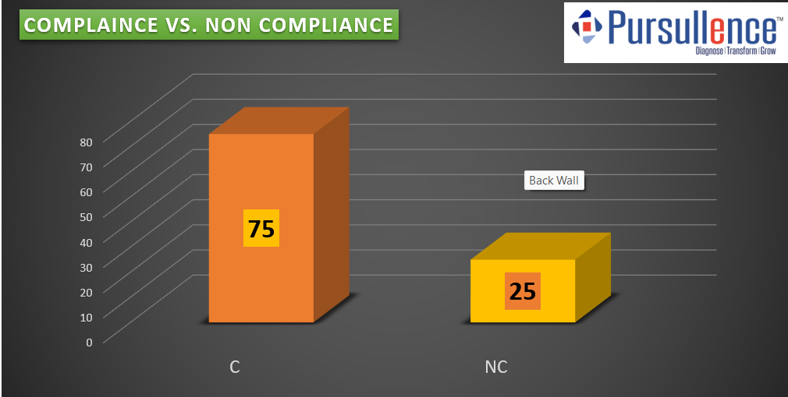
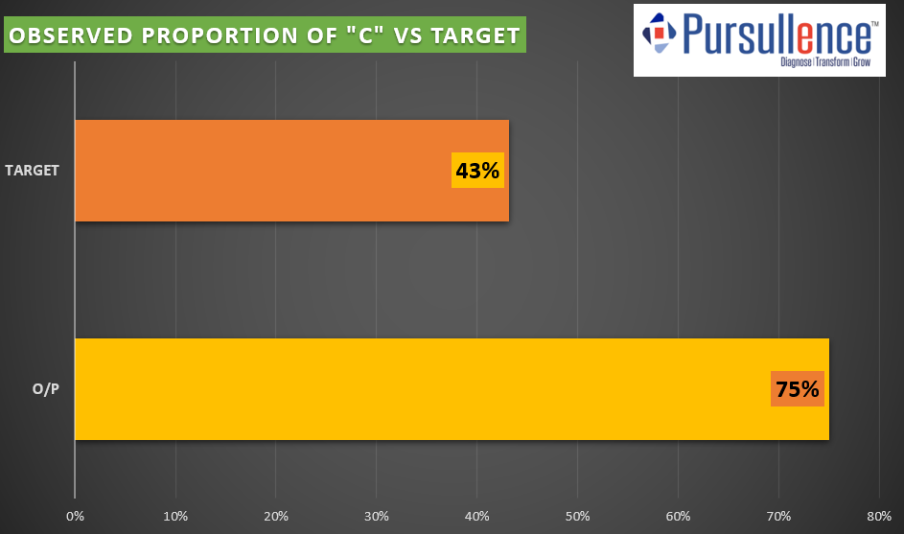
Graphical Representation
1)Plot of Compliance vs Non-compliance:
2) Plot Observed proportion of “C” vs Target:
In above graph out of the total 100 respondents:
75 individuals (or 75%) fall under Compliance (C), indicating that they agree with or support the proposed strategy/product.
25 individuals (or 25%) fall under Non-Compliance (NC), indicating that they do not support or disagree with it.
From above graph we conclude that the actual compliance level of 75% exceeds the target of 43%, indicating strong acceptance and validation of the proposed product. This suggests that the strategy is well-received and can be confidently considered for implementation.

Slide 17

Conclusion
Validation phase confirmed the new FD strategy is effective and well-received.
Key features influencing customer choices were identified using analytics.
Most proposed features gained positive feedback, showing demand for innovation.
Even less significant features provided insights and
are useful for future refinement.
The new design aligns with customer expectations and can improve satisfaction scores.
Implementation of these features can restore competitive advantage for the bank.
This project showcases the power of data-driven, customer-focused improvements.

Slide 18
Future Enhancement
Reach More Types of Customers
In the next steps, we can include different customer groups like senior citizens, people from rural areas, or wealthy individuals. This will help design FD offers that suit their specific needs.
Use Digital Feedback Tools
Adding online feedback systems (through mobile apps or websites) will help the bank understand changing customer opinions quickly and make faster improvements.
Review Offers Regularly
Since customer preferences can change over time, it’s important to regularly test and adjust the FD offers to stay updated and competitive.
Understand Customer Behaviour Better
Using tools like behaviour analysis and customer journey tracking can help the bank understand why people choose or avoid FDs, so offers can be better targeted.

Slide 19
Compare with Competitors
By studying what other banks and financial services are offering (like mutual funds or digital bonds), the bank can keep its FD products attractive.
Apply to Other Bank Products
The same research method used in this FD project can also be used to improve other products like savings accounts, recurring deposits, and loans.
Use AI for Personalization
In the future, Artificial Intelligence (AI) can help offer personalized FD schemes to customers based on their financial behaviour, making the offers more relevant and increasing customer interest.

Slide 20
Thank You

